Slide 1


s
ShobjiDealer:
A multi-vendor agri-listing platform + more!
Redefining Fresh Produces Towards Urban People.
ShobjiDealer aims to provide daily needed vegetables fresh and convenient. By connecting farmers directly with consumers, we're tackling rising food costs and ensuring farmer earnings. Our innovative platform promises to enhance farmers livelihood, reduce waste, and ensure affordable, quality produce for all.
by Hawkers Inc.

Slide 2

The Problem: A Broken Supply Chain
Hawkers Inc.

Slide 3
ShobjiDealer: Multi-vendor and more!
1
Direct Connections
2
Preorder and Scheduling
Our multi-vendor platform eliminates most of the middlemen.
Users can preorder any open produces, offered directly by the farmers. They can also schedule an order through our scheduling section.
3
Quality Assured
4
Logistics
We are doing the quality assurance job
by collaborating with
Department of Agricultural Expansion.
Processing the delivery is our responsibility. Just order, pay and get it.
Hawkers Inc.

Slide 4
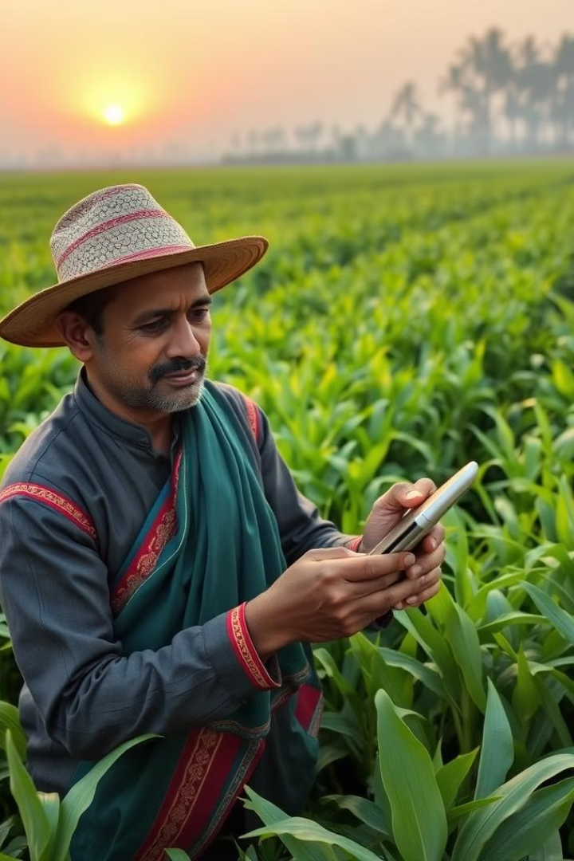
Empowering Farmers
1
Digital Literacy
We train farmers to manage their online presence. This bridges the digital divide in rural communities.
2
Fair Pricing
Transparent pricing ensures farmers receive fair compensation. No hidden fees or exploitative practices.
3
Demand Forecasting
Pre-ordering system helps farmers plan production. This reduces waste and optimizes resource allocation.

Slide 5
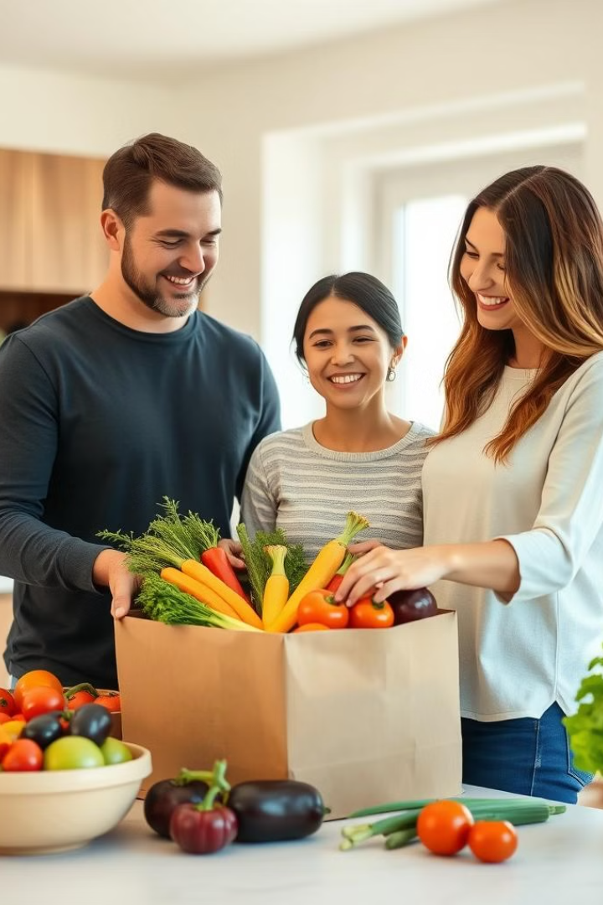
Enhancing Consumer Experience
Affordable Prices
Convenience
Easy-to-use platform for ordering and scheduling deliveries. Set up recurring orders for regular purchases.
Direct sourcing leads to significantly lower prices. Consumers enjoy fresh produce without breaking the bank.
Traceability
Quality Guarantee
Know your farmer and the journey of your food. Increased transparency builds trust and awareness.
Stringent quality checks ensure only the best produce reaches consumers. Satisfaction guaranteed or money back.

Slide 6
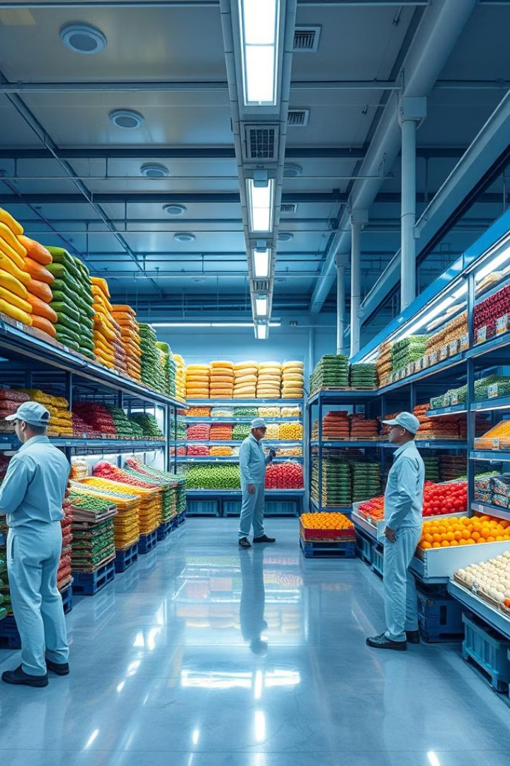



Tackling Post-Harvest Losses
Demand-Driven Production
Pre-ordering aligns production with actual demand. Farmers grow what's needed, reducing overproduction and waste.
Efficient Logistics
Optimized delivery routes minimize transportation time. Produce reaches consumers faster, maintaining freshness and quality.
Future Cold Storage
Plans to invest in cold storage facilities. This will extend produce shelf life and open export opportunities.

Slide 7
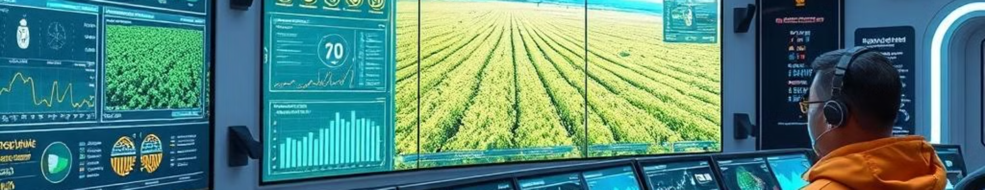



Technology at the Core
Mobile-First
Data-Driven
Blockchain Integration
Intuitive mobile app for on-the-go ordering and management. Accessible to both urban and rural users.
Advanced analytics for demand forecasting and inventory management. Helps optimize the entire supply chain.
Exploring blockchain for enhanced traceability and secure transactions. Builds trust and transparency in the system.
Hawkers Inc.

Slide 8
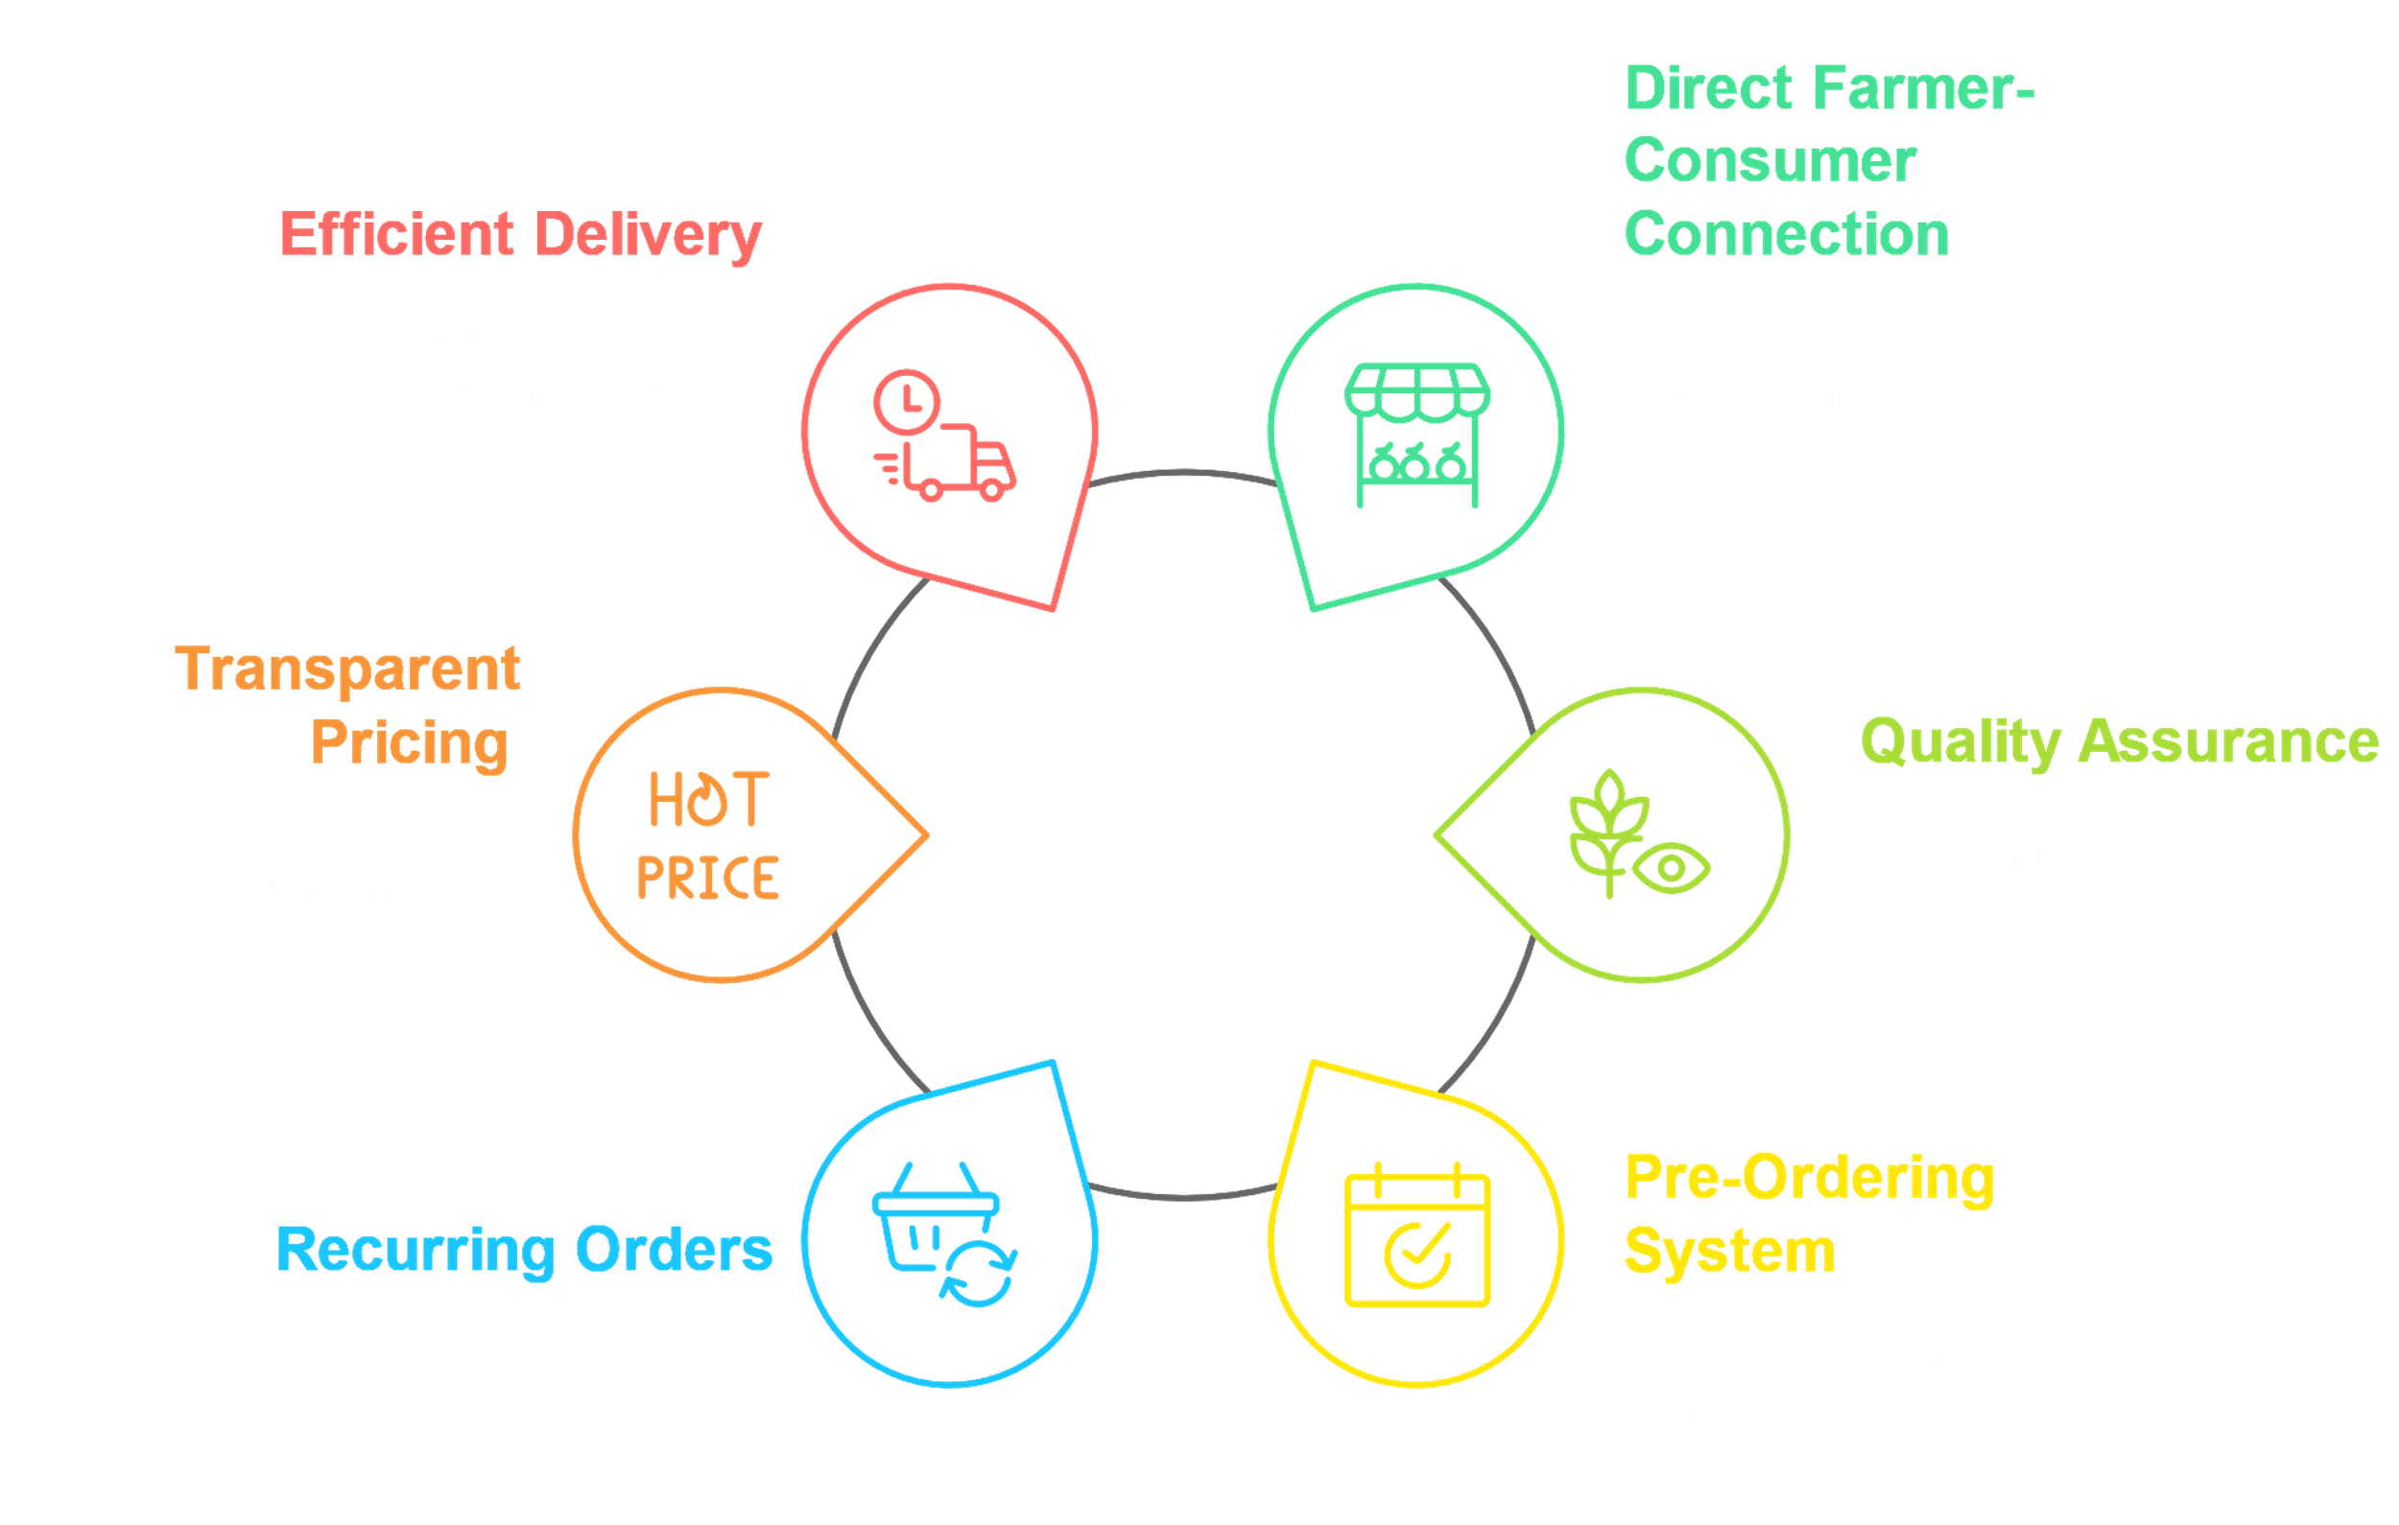
Hawkers Inc.

Slide 9
Marketing Strategy
Backward
Forward
Targeting the Gen-Z
Facebook Marketing
We're building relationships with the kids and young people in the village by getting involved in community events. They will work as our sourcing and supplier-end-manager.
We'll use Facebook to promote our platform and attract 25+ health-conscious urban people and turn them into customers.
Fitness Community
School-based Campaign
We'll participate in fitness events and offer attendees a discount on delivery fees.
We're going to set up some fun learning programs in rural schools.
Farmer Training Workshop
Van Decoration
We'll hold workshops in the fields to introduce our company and contract new suppliers.
We'll invest in our retailers’ (hawkers) vans to create a strong brand presence and drive sales.
Crop financing
Farm Visit
4
We're committed to supporting farmers through specially contract farming advance and crop financing.
4
We’ll be offering a farm tour to our potential customers
and have a hands on experience

Slide 10
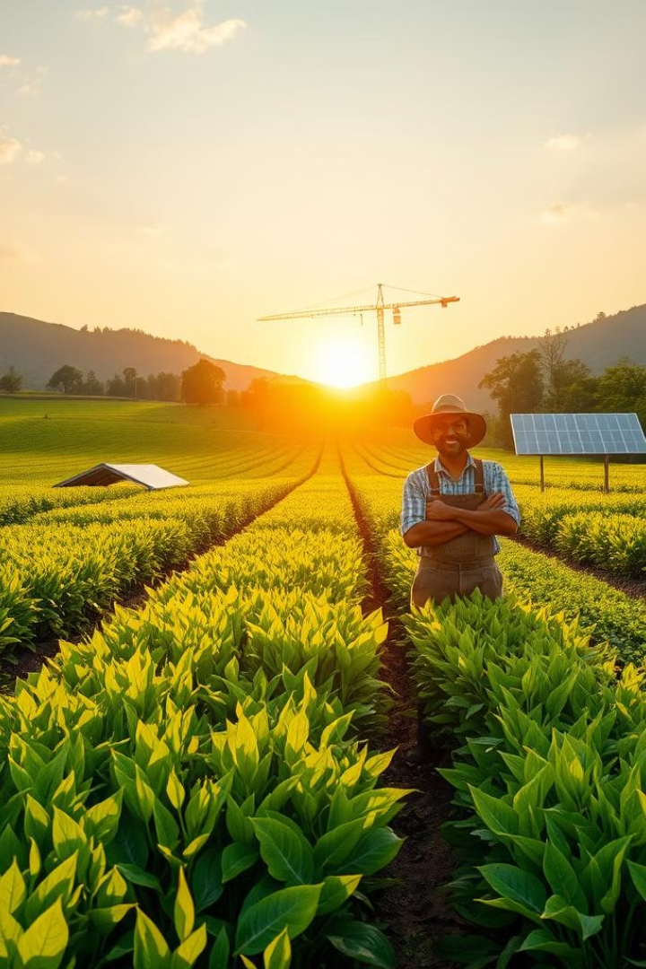
Environmental and Social Impact
Reduced Food Waste
Lower Carbon Footprint
Rural Development
20% decrease in post-harvest losses
30% reduction in transportation emissions
10,000 farmers empowered in year one
$500 million annual savings
Equivalent to planting 1 million trees
15% increase in rural household incomes

Slide 11
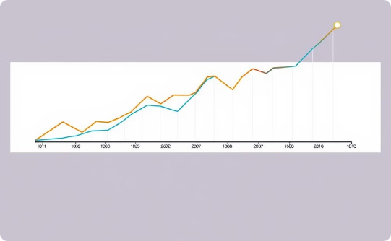
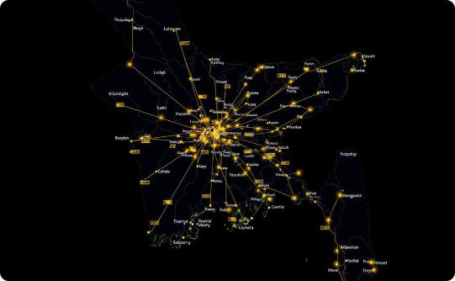

Financial Projections and Scalability
Revenue Growth
Market Expansion
Team Growth
Projected 200% year-over-year growth for the first 3 years. Break-even expected by end of year 2.
Starting in Dhaka, expanding to all major cities within 18 months. Rural penetration planned for year 3.
Current team of 20 to expand to 100+ within 2 years. Focus on local talent and agricultural expertise.
Hawkers Inc.

Slide 12
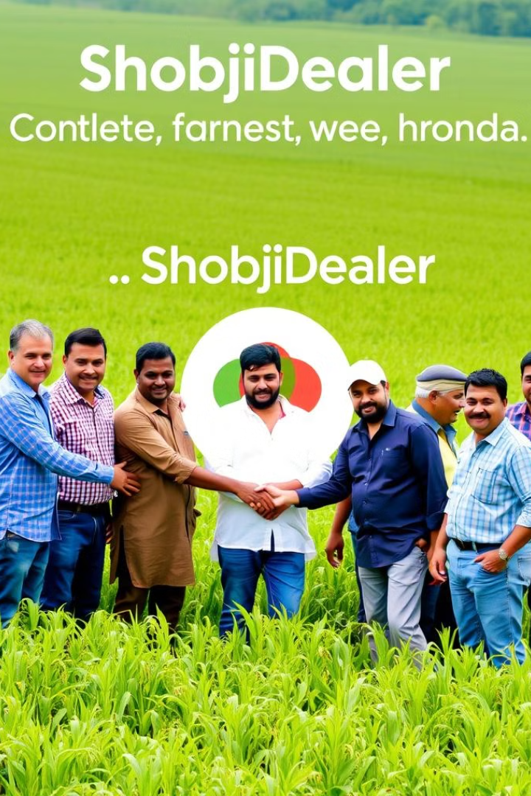
Join the Agricultural Revolution
1
Invest in Impact
2
Scalable Model
ShobjiDealer offers more than profits. It's a chance to transform lives and promote sustainable agriculture.
Our platform can be adapted to other developing markets. The potential for growth is immense.
3
Be Part of the Change
Together, we can create a more efficient, equitable, and sustainable food system for Bangladesh.
Hawkers Inc.

